Slide 1
Penetration Testing Wireless Networks
Lecturer Eugene McLaughlin
Original Slides : David Collins

Slide 2
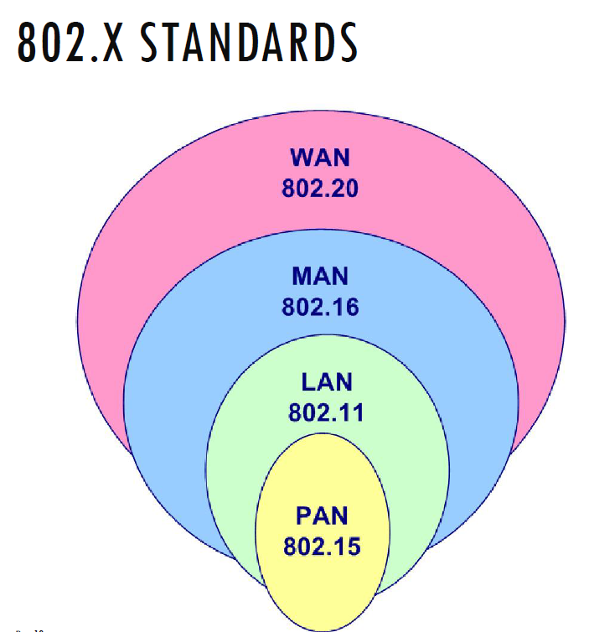
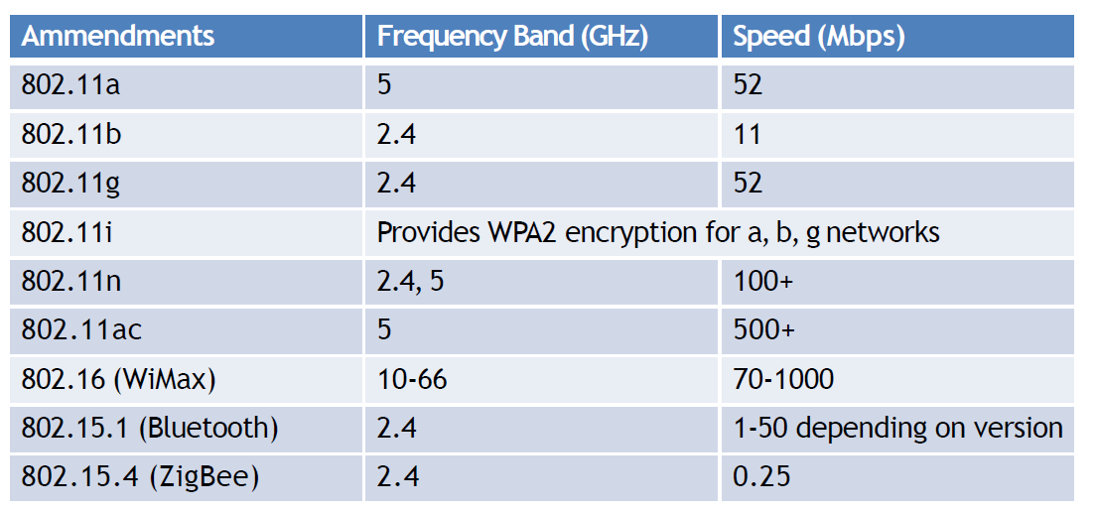
WLAN STANDARDS

Slide 3
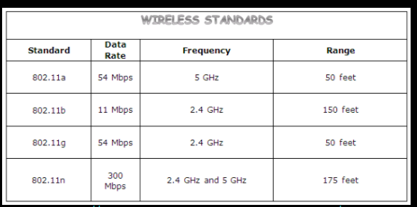
Wireless Networks
Important Terms:
Access Point: The point where the mobile device, computers connect to the wireless network.
SSID: Service Set Identifier identifies the access point, it is a human-readable text which when broadcast leads to the identification of an access point.
BSSID: Mac address of the Access point.
Bandwidth: Amount of information that can be transferred over the connection.

Slide 4
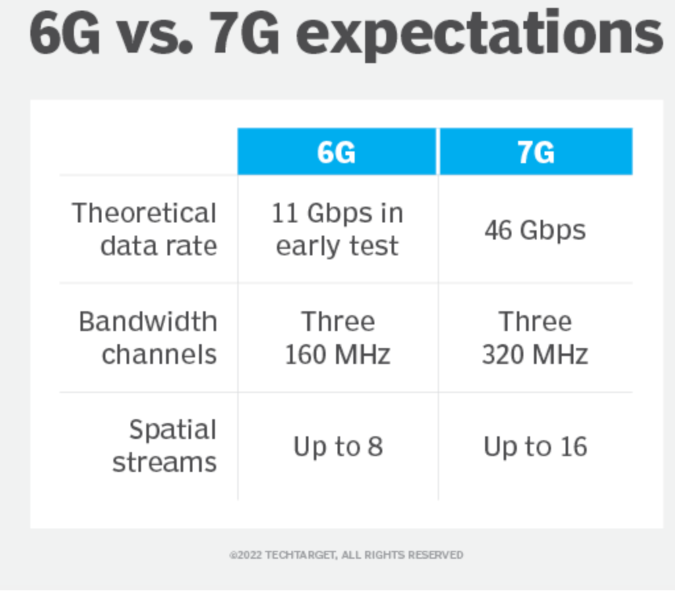
Wireless Networks
https://www.techtarget.com/searchnetworking/definition/6G

Slide 5
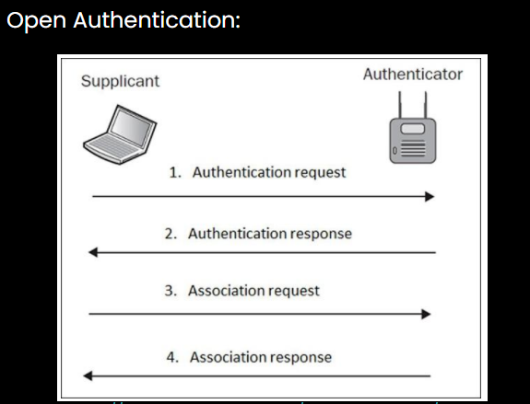
Wireless Networks
When a client wants to connect to an open access point he/she sends a probe request, and the AP sends a probe response; the client then sends an authentication request. Upon receiving a response, the client establishes an association with the AP.

Slide 6
Wireless Networks
Cracking The Handshake
In this type of attack, the attacker forces all clients to connect from the router, and when they go to reconnect (the default behaviour for client devices), the attacker captures the handshake. This can then be cracked offline to reveal the Wi-Fi password.
There are four key stages to this attack:
Scanning - Identify the target network.
De-authentication - Boot the clients on the network.
Capturing the handshake – As the clients reconnect, the 4way handshake is exchanged, and captured.
Cracking – The captured 4-way handshake is cracked to provide the plaintext Wi-Fi password.
Notes:
https://github.com/v1s1t0r1sh3r3/airgeddon

Slide 7
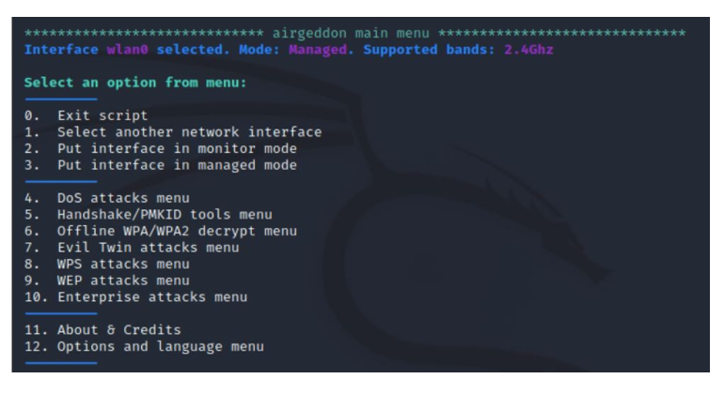
Wireless Networks
Airgeddon is a bash script that provides a command-line interface to a number of different Wi-Fi testing and auditing tools. The benefit of Airgeddon is that it streamlines the process of capturing and cracking wireless network credentials – whilst still requiring the user to understand the underlying processes and technologies.

Slide 8
Wireless Networks
Scanning:
Placing Adapter into Monitor mode and listening for all Wi-Fi broadcasts in surroundings
Deauthentication and Capture:
Looks to capture the 4-way handshake.
Cracking The password:
Cracked to reveal the password. The tool crunch can be used for brute force methods

Slide 9
Wireless Networks
The Defence
Wi-Fi Passwords – Change the default Wi-Fi password to something longer, and more complex. There are several online tools that can generate a complex and randomized password. With a complex password, you are effectively increasing the time it would theoretically take for an attacker to crack the password – small tweaks in complexity can exponentially increase the time required to crack the password.
2. Asset Review – Routinely go into your router’s admin console and have a look at the connected devices (instructions can be found for each router online). Review the PC names and look for unusual or unfamiliar devices that might indicate an unauthorized device. If in doubt, change the password on the router – this will disconnect all devices, and allow you to only grant access to personal and known devices.

Slide 10
Wireless Networks
3. Implement Whitelisting – Whitelisting is the process of providing the router with only the mac addresses of the assets you want to connect to your router. While there are ways to get around this (Mac Address Spoofing) it should provide an extra level of protection – and alerting if any unlisted devices attempt to connect.
4. Lastly, be aware of the techniques that can be used against you. If you notice a device keeps disconnecting for no reason – it could indicate someone attempting this attack. Being aware of the techniques allows you to spot the patterns of activity that indicate an attack or potential attack is taking place. If you see this type of activity, keep an eye on assets connected to the network, and look at changing your password to something longer and more complex.

Slide 11
Wireless Security
All Wi-Fi security protocols are certified by the Wi-Fi Alliance, the non-profit organization that owns the Wi-Fi trademark. There are four wireless security protocols currently available:
Wired Equivalent Privacy (WEP)
Wi-Fi Protected Access (WPA)
Wi-Fi Protected Access 2 (WPA 2)
Wi-Fi Protected Access 3 (WPA 3)

Slide 12
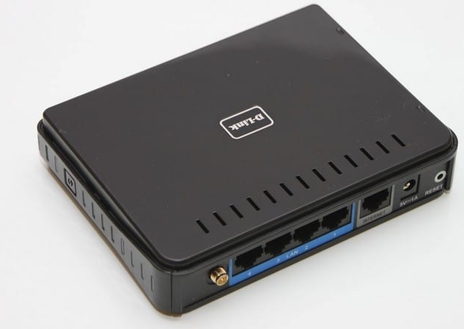
Wireless Security
What is WPS?
WPS stands for WiFi Protected Setup, and its purpose is to make a connection between a wireless device and a router a lot easier. This technology will only work with wireless networks that require a password and are encrypted with the security protocols WPA Personal or WPA2. One thing to keep in mind is that WPS will not work if the wireless network being used is using the security protocol WEP security.
WPS is made to simplify the process of connecting your device to a wireless network. With WPS, you can skip the process of having to successfully connecting to a network and then having to enter the password. It makes everything easier since it will set up a wireless network with an SSID and secure WPA data encryption and authentication.

Slide 13
Wireless Security
What is WEP (Wired Equivalent Privacy)?
WEP (Wired Equivalent Privacy) is the oldest and most common Wi-Fi security protocol. It was the privacy component established in the IEEE 802.11, a set of technical standards that aimed to provide a wireless local area network (WLAN) with a comparable level of security to a wired local area network (LAN).
The Wi-Fi Alliance ratified WEP as a security standard in 1999. Once touted to offer the same security benefits as a wired connection, WEP has been plagued over the years by many security flaws. And as computing power has increased, these vulnerabilities have worsened. Despite efforts to improve WEP, it’s still vulnerable to security breaches. The Wi-Fi Alliance officially retired WEP in 2004.
Any systems still using WEP should be either upgraded or replaced.

Slide 14
Wireless Security
What is WPA (Wi-Fi Protected Access)?
WPA (Wi-Fi Protected Access) is a wireless security protocol released in 2003 to address the growing vulnerabilities of its predecessor, WEP. The WPA Wi-Fi protocol is more secure than WEP because it uses a 256-bit key for encryption, which is a major upgrade from the 64-bit and 128-bit keys used by the WEP system.
WPA also uses the Temporal Key Integrity Protocol (TKIP), which dynamically generates a new key for each packet, or unit of data. TKIP is much more secure than the fixed-key system used by WEP.
Still, WPA is not without flaws. TKIP, the core component of WPA, was designed to be implemented onto WEP-enabled systems via firmware updates. This resulted in WPA still relying on easily exploitable elements.

Slide 15
Wireless Security
What is WPA2?
WPA2 (Wi-Fi Protected Access 2) is the second generation of the Wi-Fi Protected Access wireless security protocol. Like its predecessor, WPA2 was designed to secure and protect Wi-Fi networks. WPA2 ensures that data sent or received over your wireless network is encrypted, and only people with your network password have access to it.
A benefit of the WPA2 system was that it introduced the Advanced Encryption System (AES) to replace the more vulnerable TKIP system used in the original WPA protocol. Used by the US government to protect classified data, AES provides strong encryption.
Unfortunately, like its predecessor, WPA2-enabled access points (usually routers) are vulnerable to attacks through WEP. To eliminate this attack vector, disable WEP and, if possible, make sure your router’s firmware doesn’t rely on WEP.

Slide 16
Wireless Security
What about WPA3?
WPA3 (Wi-Fi Protected Access 3) is the newest wireless security protocol designed to encrypt data using a frequent and automatic encryption type called Perfect Forward Secrecy. It’s more secure than its predecessor, WPA2, but it hasn’t been widely adopted yet. Not all hardware supports WPA3 automatically, and using this protocol often requires costly upgrades.

Slide 17
What is WPA3?
As you might already know, the Wi-Fi Alliance developed Wi-Fi Protected Access (WPA) and Wi-Fi Protected Access II WPA2
The primary goal of the two security protocols and security certification programs has always been to secure wireless computer networks.
WPA3 is the latest version of the protocol. The new standard is meant to simplify the process of setting up devices with no visible display interface and to mitigate security issues posed by easily detectable passwords.
WPA3 will be on place to provide a secure connection, and Wi-Fi 6 will make sure that the wireless networks will be able to handle the steadily growing amounts of connected devices that businesses and homes need. However, we have to remember that the more connected devices you have, the higher will be the risk of cyber-attacks as more devices will simply give more possible entryways to hackers who are after your sensitive information

Slide 18
Why WPA3
The old ways of WPA2 relied on handshakes—a.k.a. passcodes and/or phrases—to authenticate devices before allowing them to access a network. In 2017, a vulnerability known as “KRACK” uncovered and took advantage of a recent exploit that permits Wi-Fi network access even without these credentials.
WPA3 is designed to prevent these attacks by implementing more rigorous protections that restrict network access in any scenario where a user’s passcode or phrase falls short of minimal enterprise security requirements.
Wi-Fi networks don’t always require users to connect with a password, and these unencrypted networks can and will be used by many to target unprotected data. WPA3 is designed to protect users connected to these open, publicly accessible networks.
Processes to connect devices without a screen (like IoT devices) to Wi-Fi networks are costly and time-consuming. Most devices require an additional application, if not an entirely unique, specialized process. In the future, WPA3 could provide an easier method for making this task possible. Perhaps even something as simple as a “press this button to connect” option.

Slide 19
Is WPA3 Secure
While WPA3 is a significant step forward, it has shown Vulnerabilities in its first year of activity. WPA3’s handshake process (nicknamed Dragonfly) has been affected by password partitioning attacks, which can allow network attackers to steal passcodes and phrases under the right conditions using side-channel attacks.
Even with patches, some technologies still lack the ability to enforce WPA3 standards unless the network infrastructure they’re connected to also supports this updated protocol. This lack of updated connectivity and compatibility has the potential to create security gaps and decreased enterprise adoption of WPA3-enabled technologies.

Slide 20
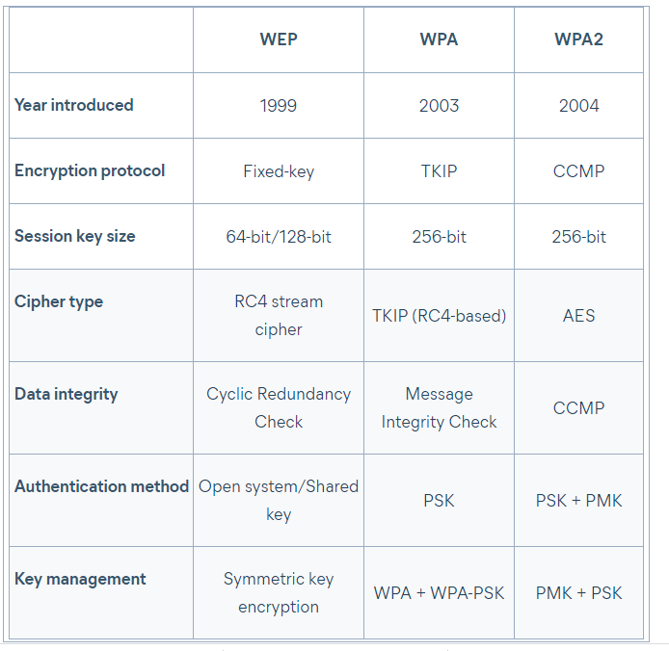
Wireless Security

Slide 21
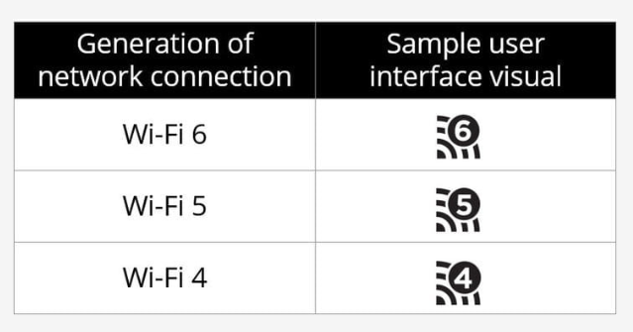
Wi-Fi 6 is coming - - - >
Wi-Fi 6 is the next-generation wireless Wi-Fi® based on the latest 802.11ax technology. The technology will still be called 802.11ax, but the devices that are compatible with the new standard will be called Wi-Fi 6 compatible. Here’s a quick explanation of what previous versions of Wi-Fi® are called;
Wi-Fi 6 is used to identify devices that support 802.11ax technology
Wi-Fi 5 is used to identify devices that support 802.11ac technology
Wi-Fi 4 is used to identify devices that support 802.11n technology
Wi-Fi 6 comes with many advantages when compared to the previous versions. With the latest option users will enjoy faster speeds, and an increased amount of possible connections passing through a device and will generally deliver better experiences to users using Wi-Fi. The latest Wi-Fi 6 will be backwards compatible and would still work with Wi-Fi 4 and Wi-Fi 5 devices. However, we wanted to highlight that only Wi-Fi 6-compatible equipment such as the latest tablets, phones, notebooks, thermostats, and video cameras will be the only ones able to take full advantage of the new technology. So when you are purchasing your next router, laptop, or smartphone, look for the Wi-Fi CERTIFIED 6™ mark.
https://www.intel.com/content/www/us/en/gaming/resources/wifi-6.html
https://youtu.be/B5N4_VD4nho?si=oQlwCjHgY3nTHNJ8
https://www.truecable.com/blogs/cable-academy/wifi-7-vs-wifi-6-whats-the-difference?srsltid=AfmBOooRN8XUNepg1VMjsPc3fIAvSE2T-svCnf4rLKohoTEMqvyKs0kE

Slide 22
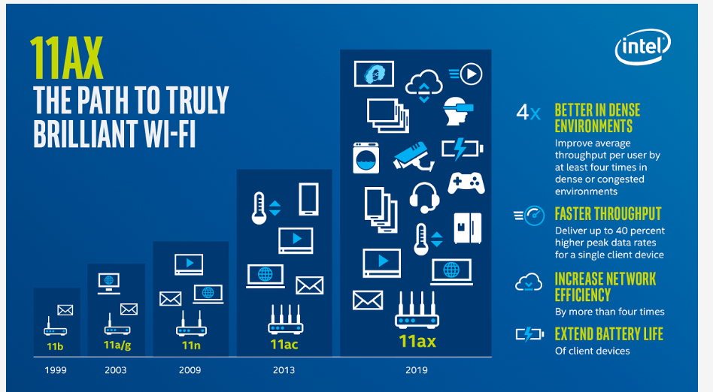
Wi-Fi 6: What’s Different, and Why it Matters

Slide 23
Benefits
Wi-Fi 6 brings in significant improvements through key enabling technologies such as MU-MIMO & OFDMA to achieve faster and highly optimized Wi-Fi performance. Let’s take a closer look at some of the advantages of using Wi-Fi 6 technology:
Increased capacity and higher data rates: With 1024QAM, Wi-Fi 6 can deliver a 25% increase in capacity over 256QAM, as in previous Wi-Fi generations, particularly at close distances..
Simultaneous Multi-user operations: Wi-Fi 6 is capable of reducing congestion in the network by allowing more devices to connect. It is enabled through MU-MIMO technology and OFDMA.
Improved power efficiency: Target Wake Time (TWT), a feature in Wi-Fi 6 networks, lets routers schedule check-in times with devices. This allows devices to plan communications with a router in advance, thus reducing the amount of time they need to keep their antennas powered on to transmit and search for signals. It improves the battery life of devices and routers for low-power Wi-Fi devices. The TWT mechanism was originally introduced in the IEEE 802.11ah amendment.
Performance in hyper-dense environments: Multiple Access Points deployed in dense device environments can collectively deliver the desired QoS to clients with diverse usage profiles in Wi-Fi 6. It can significantly increase the aggregate wireless network throughput to address high-density venues such as stadiums, auditoriums, retail chains, malls, etc.

Slide 24
Types of Wireless Attacks
Fake Wi-Fi Access Points, Evil Twins, and Man in the Middle Attacks
Packet Sniffing: Interception of Unencrypted Traffic
Wardriving
Warshipping
MAC Spoofing

Slide 25
Fake Wi-Fi Access Points, Evil Twins, and Man in the Middle Attacks
Visitors to hotels, coffee shops and malls often connect to the free Wi-Fi on offer,
but various studies have shown that care is not always taken when connecting. Customers often choose the Wi-Fi access point based on the SSID without checking it is the wireless network set up by a particular establishment for customer use.
Criminals can easily set up fake Wi-Fi access points,
often using the name of the establishment in the SSID. An SSID called ‘Free Airport Wi-Fi’ would be enough to get many people to connect. When customers connect to these rogue Wi-Fi networks, they can still access the Internet, so are unlikely to realize anything is wrong. However, once connected to that network, everything they do online will be monitored by cybercriminals.
Sensitive information entered online, such as email addresses and passwords, credit card numbers, or banking credentials, can and will be stolen.

Slide 26
Fake Wi-Fi Access Points, Evil Twins, and Man in the Middle Attacks
How is this done?
The attacker simply creates a hotspot on a smartphone and pairs it with a tablet or laptop. The hacker can then sit in a coffee shop drinking a latte while monitoring the traffic of everyone that connects.
Alternatively, they can use a router with the same name and password as the one currently in use. This may also have a stronger Wi-Fi signal, which may see more people connect. Through the “evil twin” all traffic will be plainly visible to the attacker and all data sent over the network can be captured.
Fake access points and evil twins are among the most common wireless network attacks. They are easy to conduct, require little technical skill, and are very effective.
One study indicated more than a third of Wi-Fi hotspot users take no precautions when accessing Wi-Fi hotspots and frequently connect to unsecured networks.

Slide 27
Packet Sniffing: Interception of Unencrypted Traffic
Research by Kaspersky Lab in 2016 showed more than a quarter of public Wi-Fi hotspots set up in malls were insecure and lacked even basic security controls.
A quarter did not encrypt traffic at all, while research conducted by Skycure showed that five of the 10 busiest malls in the USA had risky Wi-Fi networks.
One mall in Las Vegas was discovered to be operating 14 risky Wi-Fi access points. Hackers can use packet sniffers to intercept traffic on unencrypted Wi-Fi networks. Packet sniffing is one of the most common wireless attacks.
These common wireless network attacks are easy on older routers, such as those using WEP encryption. WPA offers better security, WPA2 is better still, or ideally, the new WPA3 encryption protocol should be used if it is supported by your access point.

Slide 28
Wardriving
War driving is a technique used to identify and map vulnerable access points.
The name comes from the fact that attackers drive around a neighborhood and use a laptop with a GPS device, antenna to identify and record the location of wireless networks.
This technique is effective, since many Wi-Fi networks used by businesses extend beyond the confines of the building and poor security controls are applied to secure those networks.
https://www.wigle.net/

Slide 29
Warshipping
Warshipping is a more efficient method of attacking Wi-Fi networks as it allows attacks to be conducted remotely, even if the attacker is not within range of a Wi-Fi network. The tactic was explained by IBM X-Force Red researchers at Black Hat USA. They used cheap (under $100) and easy-to-obtain components to create a single-board computer with Wi-Fi and 3G capabilities that runs on a cell phone battery. The device can be used to locally connect to the Wi-Fi network and send information back to the attackers via the 3G cellular connection.
Since the device is small, it can easily be hidden inside a small package and getting that package into a building is easy. It can just be mailed. Since the package may be addressed to someone not working in the company, it could sit in the mailroom for a while before it is opened. Since the package can be tracked, the attackers will know when it is in the building. Alternatively, it could be hidden in any number of items from plant pots to teddy bears. If the device is within the range of Wi-Fi networks, it could be used to attack those networks.
Hashed network access codes can be sent back to the attackers to crack, and the device can then connect to Wi-Fi networks in the building and harvest data. The device could be used in a man-in-the-middle attack by impersonating an internal Wi-Fi network.

Slide 30
MAC Spoofing
Many businesses use MAC filtering to prevent specific devices from connecting to their Wi-Fi networks.
While this is useful for preventing individuals from taking advantage of free Wi-Fi for customers, this method of blocking users can be easily bypassed.
It is easy to spoof a MAC address and bypass this filtering control.

Slide 31
Examples of Wi-Fi Network Attacks
Toasters Used to Hack Unsecured Wi-Fi Networks
Perhaps not one of the most common Wi-Fi network attacks, but notable none the less due to the rise in use of IoT devices. IoT capability has been incorporated into all manner of devices from toasters to washing machines.
These devices can be vulnerable to supply chain attacks –
Where hardware is altered to allow the devices to be used to attack Wi-Fi networks.
In 2016, Russian officials discovered chips imported from China had been altered and were being used to spread malware that could eavesdrop on unsecured Wi-Fi networks from a range of 200 meters.
They were used to infect those networks with malware that could steal information.

Slide 32
Examples of Wi-Fi Network Attacks
In-Flight Wi-Fi Network Hacked from the Ground
Cybersecurity expert Ruben Santamarta has demonstrated it is possible to hack into airline Wi-Fi networks from the ground and view the internet activity of passengers and intercept their information.
More worryingly, he was also able to gain access to the cockpit network and SATCOM equipment. He claims the same technique could be used for ships, industrial facilities and even military installations.
He explained how he did it in his “Last Call for SATCOM security” presentation at the 2018 black hat hacker conference.

Slide 33
Examples of Wi-Fi Network Attacks
Imagine coming back home and finding your favourite food left at the door. No, you hadn’t been to the grocery store in weeks and hadn’t called or ordered any of it through apps.
Companies have now come up with smart refrigerators to learn our food preferences, take stock of supplies, and even order food that is low on stock!
As the reach of IoT continues to grow, more and more devices, both household and workplace, now feature embedded internet connectivity.
Even devices like toothbrushes and children’s toys have become a lot smarter and boast internet-related services. This may be to give users a better experience, or simply a way for manufacturers to gather information.
Botnets can also help hackers take over your home network devices and use them to perform illegal activities. Cybercriminals who have gained access to your smart devices could spy on you and later use it for blackmail.

Slide 34
How Can Businesses Prevent the Most Common Wireless Network Attacks?
Isolate the Guest Network
If your business network is not isolated from your guest Wi-Fi network, it could be used to gain access to business data and could place your POS at risk of compromise. Use a router that offers multiple SSIDs – most modern routers have that functionality.
These routers often have a guest SSID option or separate guest portal. Make sure it is activated when it is deployed. Alternatively, your wireless router may have a wireless isolation feature that will prevent Wi-Fi users from accessing your internal network and other client devices.
If you require multiple access points throughout your establishment, you are likely to need a VLAN or EoIP tunnel configuration

Slide 35
How Can Businesses Prevent the Most Common Wireless Network Attacks?
Encrypt Wi-Fi Traffic with WPA2 or WPA3
If you have an old router that does not support WPA2 encryption it’s time for an upgrade. WPA2 is the minimum standard for Wi-Fi security, and while it can still be cracked, it is time-consuming and difficult. WPA3 has now been released and an upgrade should be considered. You should also make sure that WPS is turned off.
Update Firmware Promptly
All software and devices contain vulnerabilities and require updating. Software should be patched and devices such as routers will need to have their firmware upgraded when new versions are released. Check your device manufacturers website periodically for details of firmware updates and ensure your device is updated.

Slide 36
How Can Businesses Prevent the Most Common Wireless Network Attacks?
Create a Secure SSID
Your router will have a default SSID name, but this should be changed to personalize it to your business. If you make it easily identifiable, it will reduce the potential for rogue access points to be confused with your own. Ensure that you enforce WPA2 encryption with a shared key and post that information for your customers along with your SSID in a prominent place where they can see it.
Restrict Wi-Fi Access
If your wireless router or access point is too powerful, it could be accessed from outside your premises. Choose a router that allows you to alter the strength of your signal and you can ensure only your customers will use your connection. Also, ensure that your Wi-Fi access point is only available during business hours. If your access points are left unsupervised when your business is closed, it increases the risk of an attack.
Secure Your Infrastructure
Administrator access can be abused, so ensure that your login name and your passwords are secure. If the default credentials are not changed, it will only be a matter of time before they are abused. Change the username from ‘admin’ or any other default username. Set a strong password that includes upper and lower-case letters, at least one number, and a special character. The password must be at least 8 characters although more is better. Alternatively use a 14-character+ passphrase.

Slide 37
How Can Businesses Prevent the Most Common Wireless Network Attacks?
Use a Web Filter
A web filtering solution is an essential protection for all Wi-Fi networks.
Web filters will prevent users from visiting websites and web pages that are known to have been compromised or have been confirmed as malicious.
This will protect your customers from web-based threats such as drive by downloads, exploit kits and phishing. A web filter will also allow you to prevent your network from being used to download or view unacceptable content such as pornography and lets you control bandwidth usage to ensure all customers can enjoy decent Internet speeds.

Slide 38
The WPS threat
Worst of all is Wi-Fi Protected Setup (WPS), an ease-of-use feature that lets users
bypass the network password and connect devices to a Wi-Fi network simply by
entering an eight-digit PIN that's printed on the router itself.
If the network password or network name is changed, the PIN remains valid.
"This is a huge expletive-deleted security problem,"
"That eight-digit number will get you into the [router] no matter what. a plumber comes over to your house, turns the router over, takes a picture of the
bottom of it, and he can now get on your network forever.“
That eight-digit PIN isn't even really eight digits, It's actually seven digits, plus a final checksum digit.
The first four digits are validated as one sequence and the last three as another
resulting in only 11,000 possible codes instead of 10 million.
"If WPS is active, you can get into the router, "You just need to make 11,000 guesses“
— a trivial task for most modern computers and smartphones.

Slide 39
Port open 32764
Then, there's networking port 32764, which French security researcher Eloi Vanderbeken in 2013 discovered had been quietly left open on gateway routers sold by several major brands. Using port 32764, anyone on a local network — which includes a user's ISP — could take full administrative control of a router, and even perform a factory reset, without a password.
The port was closed on most affected devices following Vanderbeken's disclosures, but he later found that it could easily be reopened with a specially designed data packet that could be sent from an ISP.

Slide 40
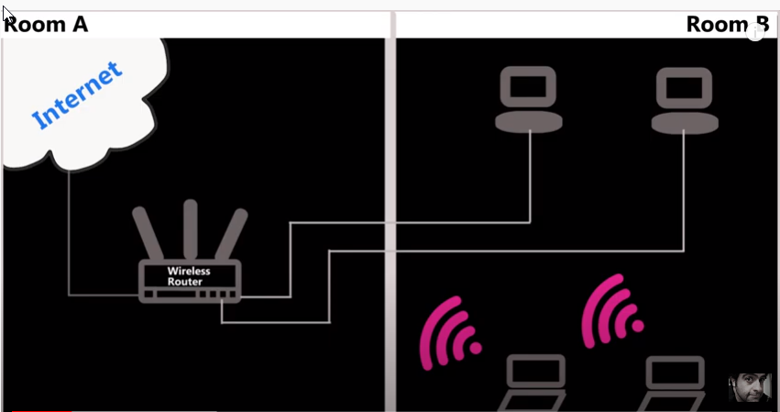
Connect two Networks via Cables

Slide 41
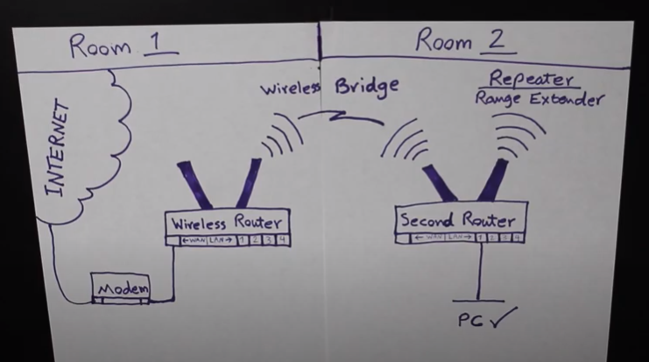
Connect using a wireless repeater Bridge?
Notes:
https://www.youtube.com/watch?v=rsWfFGCBnnM

Slide 42
Connect using a wireless Bridge extends wireless

Slide 43
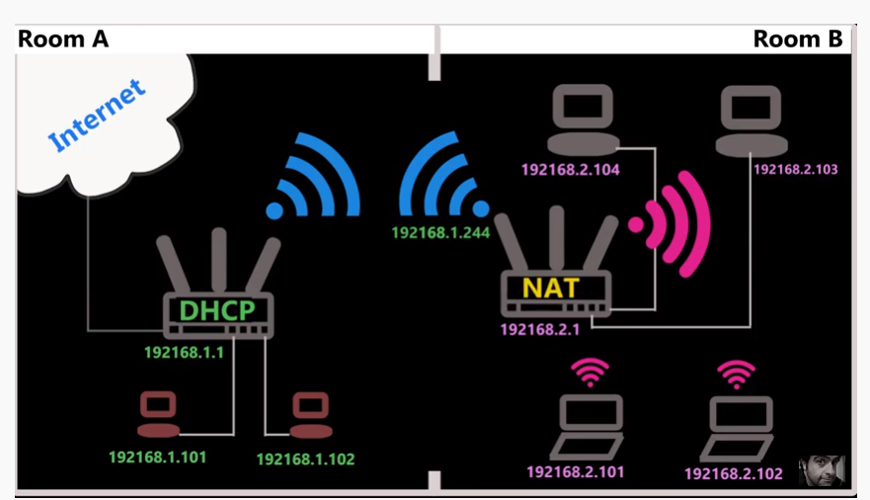
Connect using a Wireless NAT works like a router not in bridged mode

Slide 44
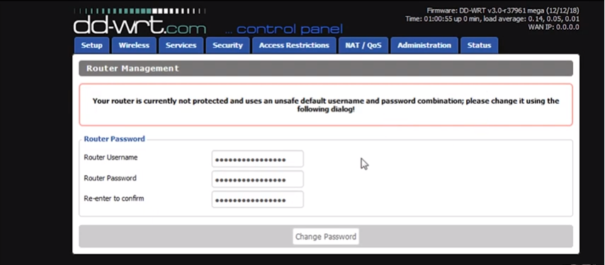
DD WRT Login page?

Slide 45
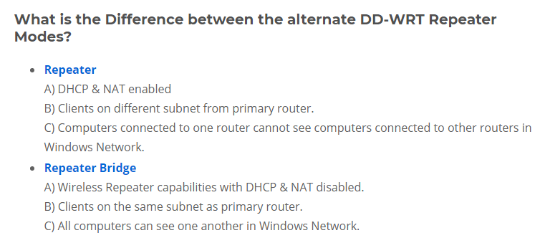
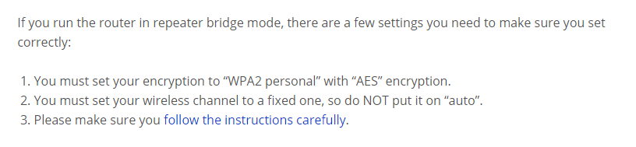
DD WRT Set up set up in repeater or Repeater Bridge mode
https://wiki.dd-wrt.com/wiki/index.php/Repeater_Bridge

Slide 46
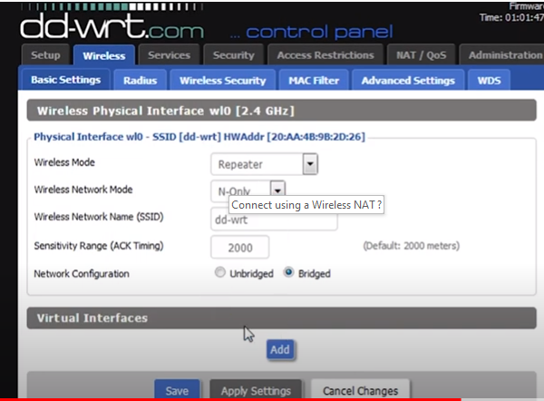
DD WRT Set up set up in repeater mode

Slide 47
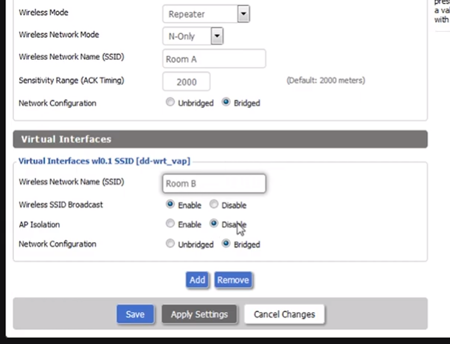
DD WRT Login page?

Slide 48
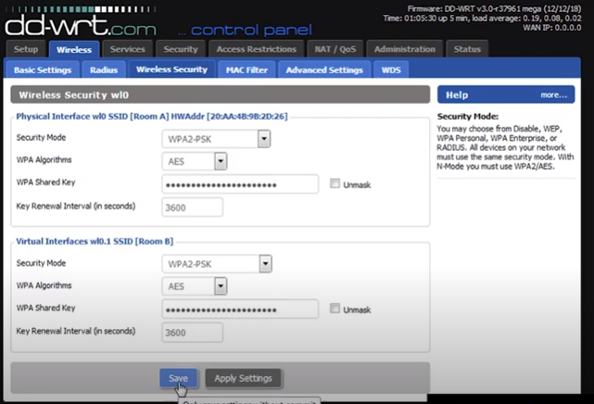
DD WRT Login page?

Slide 49
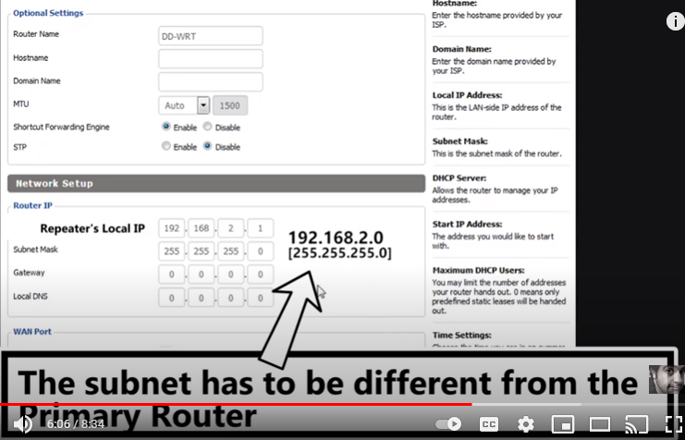
DD WRT Login page?

Slide 50
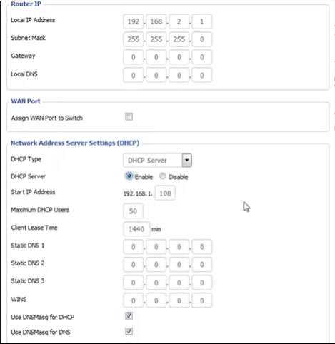
DD WRT second router enable DHCP

Slide 51
Router Security
Easy fixes
Change the administrative credentials from the default username and password. They're the first things an attacker will try. Your router's instruction manual should show you how to do this. If it doesn't, then Google it.
Make the password long, strong and unique, and don't make it anything resembling the regular password to access the Wi-Fi network.
Change the network name, or SSID, from "Netgear," "Linksys" or whatever the default is, to something unique — but don't give it a name that identifies you.
"If you live in an apartment building in apartment 3G, don't call your SSID 'Apartment 3G,'" Horowitz quipped. "Call it 'Apartment 5F.'"
Turn on automatic firmware updates if they're available. Newer routers, including most mesh routers, will automatically update the router firmware.
Enable WPA2 wireless encryption so that only authorized users can hop on your network. If your router can support only the old WEP standard, it's time for a new router.

Slide 52
Router Security
Enable the new WPA3 encryption standard if the router supports it. As of mid-2020, however, few routers and client devices (PCs, mobile devices, smart-home devices) do.
Disable Wi-Fi Protected Setup, if your router lets you.
Set up a guest Wi-Fi network and offer its use to visitors, if your router has such a feature. If possible, set the guest network to turn itself off after a set period of time.
"You can turn on your guest network, and set a timer, and three hours later, it turns itself off,“
Set your router to use the 5-GHz band for Wi-Fi instead of the more standard 2.4-GHz band, if possible — and if all your devices are compatible.
"The 5-GHz band does not travel as far as the 2.4-GHz band,“ So if there is some bad guy in your neighbourhood a block or two away, he might see your 2.4-GHz network, but he might not see your 5-GHz network."
Disable remote administrative access, and disable administrative access over Wi-Fi. Administrators should connect to routers via wired Ethernet only.
Disable PING, Telnet, SSH, UPnP and HNAP, if possible. All of these are remote-access protocols. Instead of setting their relevant ports to "closed," set them to "stealth" so that no response is given to unsolicited external communications that may come from attackers probing your network.
Notes:
https://wiki.dd-wrt.com/wiki/index.php/Wireless_security

Slide 53
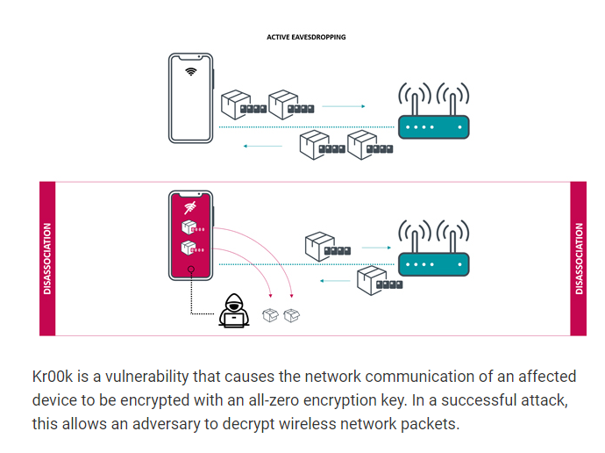
CVE-2019-15126 The discovery of Kr00k

Slide 54

Why WEP Networks Are So Vulnerable
WEP, or Wired Equivalent Privacy, was implemented in 1995 to provide the same expectation of privacy as on wired networks for users of Wi-Fi but had security problems that came to light shortly after. It was deprecated in 2004, superseded by the WPA and WPA2 encryption that you see today. The reason for this was a series of increasingly devastating attacks against the encryption used in WEP, resulting in the ability to recover the password in a matter of minutes.
WEP is a stream cipher that relies on never using the same key twice to provide security. Unfortunately, as demonstrated in several published attacks, an attacker is easily able to force the same key to be used twice by replaying network traffic in a way that forces a tremendous amount of packets to be generated. This allows an attacker to collect the data needed to determine the encryption key and crack the network password outright. With a good range and a powerful network adapter, anyone can expect to crack WEP networks in only a few minutes.
The power behind WEP hacking comes from two different parts of the attack: the ability to stimulate traffic even from a busy network and the ability to crack the network password when collecting a certain amount of that traffic. Remember that with WPA, hackers can't even capture a handshake from an empty network, but even an empty WEP network can be attacked with packet injection.
How to hack wep https://null-byte.wonderhowto.com/how-to/hack-wi-fi-hunting-down-cracking-wep-networks-0183712/
Ethical and Legal warning

Slide 55
The Old Way to Crack WPA2 Passwords
The old way of cracking WPA2 has been around quite some time and involves momentarily disconnecting a connected device from the access point we want to try to crack. That has two downsides, which are essential for Wi-Fi hackers to understand.
The first downside is the requirement that someone is connected to the network to attack it. The network password might be weak and very easy to break, but without a device connected to kick off briefly, there is no opportunity to capture a handshake, thus no chance to try cracking it.
The second downside of this tactic is that it's noisy and legally troubling in that it forces you to send packets that deliberately disconnect an authorized user for a service they are paying to use. This kind of unauthorized interference is technically a denial-of-service attack and, if sustained, is equivalent to jamming a network. It can get you into trouble

Slide 56
A New Method of Password Cracking WPA2
Rather than relying on intercepting two-way communications between Wi-Fi devices to try cracking the password, an attacker can communicate directly with a vulnerable access point using the new method. On Aug. 4, 2018, a post on the Hashcat forum detailed a new technique leveraging an attack against the RSN IE (Robust Security Network Information Element) of a single EAPOL frame to capture the needed information to attempt a brute-force attack.
Similar to the previous attacks against WPA, the attacker must be in proximity to the network they wish to attack. The objective will be to use a Kali-compatible wireless network adapter to capture the information needed from the network to try brute-forcing the password. Rather than using Aireplay-ng or Aircrack-ng, we'll be using a new wireless attack tool to do this called hcxtools. Check out the YouTube video to see how its done.
Here how to do it https://null-byte.wonderhowto.com/how-to/hack-wi-fi-cracking-wpa2-passwords-using-new-pmkid-hashcat-attack-0189379/
Ethical and Legal warning

Slide 57
Automate Wi-Fi Hacking with Wifite2
Wifite2 follows a simple but effective workflow for hacking nearby networks as rapidly as possible. To do so, it pushes each tactic it tries to the practical limit, even going to far as to try to crack any handshakes it retrieves.
In the first step, Wifite2 scans across all channels looking for any network in range. It ranks these networks it discovers by signal strength, as a network being detected does not ensure you can reliably communicate with it Organized from strongest to weakest signal strength.
The reconnaissance phase involves gathering information about what networks are around and which hacking techniques they might be vulnerable to. Because of the way Wifite2 is organized, it's easy to add a directional Wi-Fi antenna to use Wifite2 to locate the source of any nearby Wi-Fi network while performing a site survey.
After the site survey is complete, any targets displayed will show whether there are clients connected, whether the network advertises WPS, and what kind of encryption the network is using. Based on this, an attacker can select any target, a group of targets, or all targets to begin an attack based on the information gathered.
Wifite2 will progress through the target list starting with fastest and easiest attacks, like WPS-Pixie, which can result in a password being breached in seconds, on to less sure tactics like checking for weak passwords with a dictionary attack. If an attack fails or takes too long, Wifite2 will move on to the next applicable attack without wasting hours like its predecessor was prone to doing.
Ref https://null-byte.wonderhowto.com/how-to/automate-wi-fi-hacking-with-wifite2-0191739/
Ethical and Legal warning

Slide 58
NIST Password Requirements in 2019
The latest NIST guidelines for passwords,
which are called memorized secrets, can be summarized as:
Character minimums: 8 when set by a human, 6 when assigned by a system or service
Character maximums: 64 characters should be allowed
Character types: all ASCII characters (spaces included) should be supported
Password truncation: shortening should never be implemented during processing
Password checking: passwords should be checked against known password dictionaries
Password attempts: at least 10 attempts should be allowed before lockout
Password complexity and expiration: not recommended [A a 1 !] [ Pa$$WOrd1]
Password hints and knowledge based authentication (e.g. favorite food): not recommended
Password apps (such as receiving an SMS): not recommended (one time passwords from an authorized app such as Google Authenticator may be used)
https://pages.nist.gov/800-63-3/sp800-63c.html#errata

Slide 59
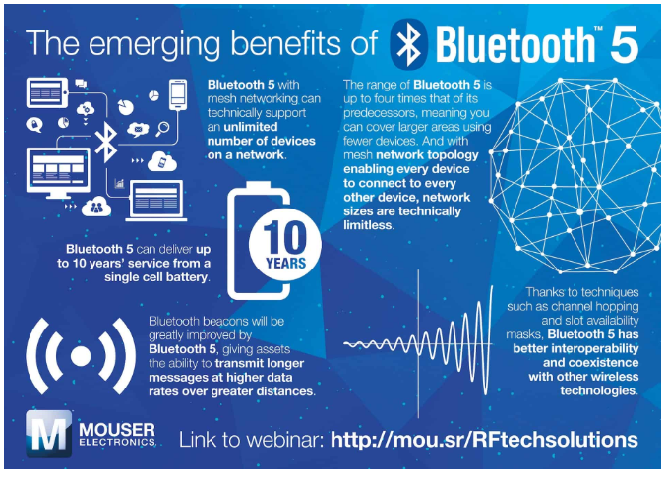

Slide 60

Step 1 – Create a new contact on the mobile phone’s contact list.
Step 2 – Enter a “Bluejacking” message in the name field such as, “I am a master Bluejacking specialist.”
Step 3 – Choose the new contact and select the “Send via Bluetooth” menu option. The purpose of this option on mobile phones is to forward contact data to others.
Step 4 – The phone will now display a list of devices that are in its range. If the phone cannot find a device, it just means that it is not in range of a Bluetooth enabled device. Select a contact from the listing and send a message.
Step 5 – If a user chooses to Bluejack other devices, he/she should be aware of the security laws in his/her place of residence. In some locations, sending unsolicited messages via Bluejacking may be illegal.
Ethical and Legal warning

Slide 61

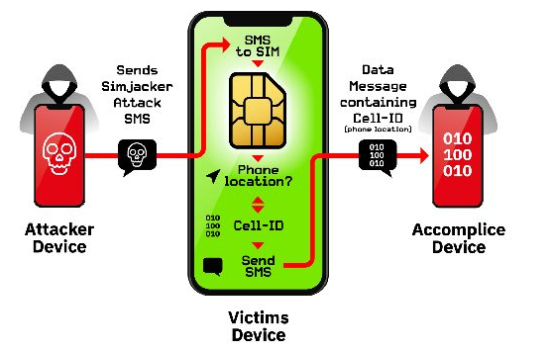
Simjacker
At its simplest, the main Simjacker attack involves a SMS containing a specific type of spyware-like code being sent to a mobile phone, which then instructs the UICC (SIM Card) within the phone to ‘take over’ the mobile phone , in order to retrieve and perform sensitive commands.

Slide 62
The Beginner's Guide to Defending Against Wi-Fi Hacking
Password Cracking
Better Passwords
Social-Engineering Attacks
Always Be Suspicious
WPS PIN Attacks
Disable WPS & Verify with Testing
Remote-Access Attacks
Disable Remote Access & Port Forwarding
Rogue Access Points
Spot Signs of a Rogue AP
More Info
https://null-byte.wonderhowto.com/how-to/beginners-guide-defending-against-wi-fi-hacking-0185217/

